Slide 1


Negative Results in Edge-Cloud-HPC Research
INDIANA UNIVERSITY BLOOMINGTON
Beth Plale
Burns McRobbie Chair of Computer Engineering
Chair, Dept of Intelligent Systems Engineering
Executive Director, Pervasive Technology Institute
Indiana University, Bloomington, Indiana USA
ERROR Workshop, Oct 10, 2023

Slide 2


With thanks to
Sadia Khan, Informatics PhD student
Sachith Withana, ISE PhD student
Yu Luo, Postdoctoral Scholar
Julie Wernert, PTI

Slide 3
Systems Research
Systems research: any work that would come out of a ``systems group'' at a research university, including operating systems, networking, distributed systems, [grid, cloud, HPC], theory about systems, etc. ¹
Systems research papers are frequently evaluated on engineering-based criteria: the applicability and utility of the research in solving real world problems. Work frequently needs to show itself “better” than a competing research work. Metrics quantitative.
¹ The Many Faces of Systems Research - And How to Evaluate Them, Brown A., et al. HotOS05

Slide 4
Systems research uses quantitative, often experimental metrics
Increase in model accuracy (incremental)
Speedup (parallelization)
Fewer messages exchanged in communication protocol
Lower latency
Lower storage, bandwidth, computational use
Lower energy use

Slide 5

A negative result in systems research is a research study that yields one or more non-favorable outcomes (metrics)
Negative results don’t get published. Researchers respond by “curating” towards positive results so that result can be published. This hurts science credibility.
Notes:
Not better than what compared against

Slide 6
Negative Results Origins in Psychology
“Publishing norms emphasize novel, positive results. As such, disciplinary incentives encourage design, analysis, and reporting decisions that elicit positive results and ignore negative results.”
“Prior reports demonstrate how these incentives inflate the rate of false effects in published science. When incentives favor novelty over replication, false results persist in the literature unchallenged, reducing efficiency in knowledge accumulation.”
Scientific Utopia: II. Restructuring Incentives and Practices to Promote Truth Over Publishability,
Brian A. Nosek, Jeffrey R. Spies, and Matt Motyl, https://doi.org/10.1177/1745691612459058

Slide 7
Preregistration as solution (origins psychology)
Well defined hypothesis, stated in advance through preregistration, publisher makes commitment to publish regardless of final outcome of study
“Research questions and analysis plan defined before observing the research outcomes—a process called preregistration.”
“Widespread adoption of preregistration will increase distinctiveness between hypothesis generation and hypothesis testing and will improve the credibility of research findings.”
Reduces the incentive to p-hack
The preregistration revolution, Brian A. Nosek, Alexander C. DeHaven, and David T. Mellor, PNAS,
https://doi.org/10.1073/pnas.170827411

Slide 8
Preregistration and hypothesis testing: applicability to systems research
Predictions lend themselves to hypothesis testing. Systems research tends to have multiple measures against which success could be measured.
So instead of p-hacking, we may see (or not see) a carefully filtered view of performance (some metrics shown, others not) in the submitted manuscript for review (“metric hacking”)
plale@indiana.edu

Slide 9
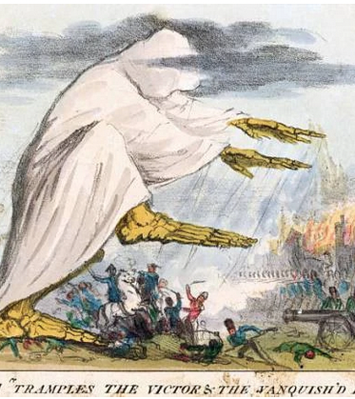
What are we encouraging with positive results lense on paper evaluation?
“metric-hacking”
Performance graphs that don’t tell the whole story. That do just enough
Iterative work
Lower rates of reproducibility. “Metric hacking” could lead to reluctance to make information available to build off piece of work or confirm finding
Cholera “tramples the victors & the vanquished both.” Robert Seymour. 1831. U.S. National Library of Medicine / Wikipedia, Public Domain.
Notes:
What we don’t see is where things start to fall part

Slide 10

Objective then is to not have author penalized (paper rejected) for results that don’t fit an expected pattern (of what is measured)
What would negative result model look like applied to our field?
Is preregistration the way to do it?
Notes:
We are encouraging papers on where things went wrong

Slide 11
Interpreting negative results and preregistration for our field
Future is journals/peer reviewed conferences who adopt practice of:
Increased appreciation and valuation of unexpected performance results
Gives fuller picture
Avoids “metric hacking” and carefully selected graph inclusion
Encouraging evaluations of broader considerations
Encouraging transparency of results reporting (reproducibility)

Slide 12

Case of large language models
Use of LLMs as conversational agents for interfacing with science research infrastructure

Slide 13


“members of a community provide to all members in order to fulfill a relational obligation they all have to care for certain interests that they have in common”
$500 million dollar investment in AI Institutes research network
Common good asks that we as cyberinfrastructure researchers care for the shared interest - that is, the innovations, the infrastructure
It is an obligation to 1) not add to misinformation, 2) not add AI innovations without assessment of potential harms, 3) not add to a resource depleted planet
National cyberinfrastructure a hundreds of millions of dollars investment

Slide 14

Public in US has resiliently high regard for science
Misinformation can over time erode the confidence that citizens have in the scientific methodology, and reduce confidence in scientists' commitment to acting in the public interest
This applies to the systems we build that facilitate scientific research

Slide 15
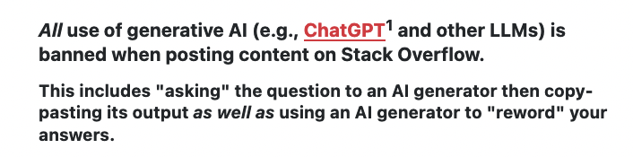
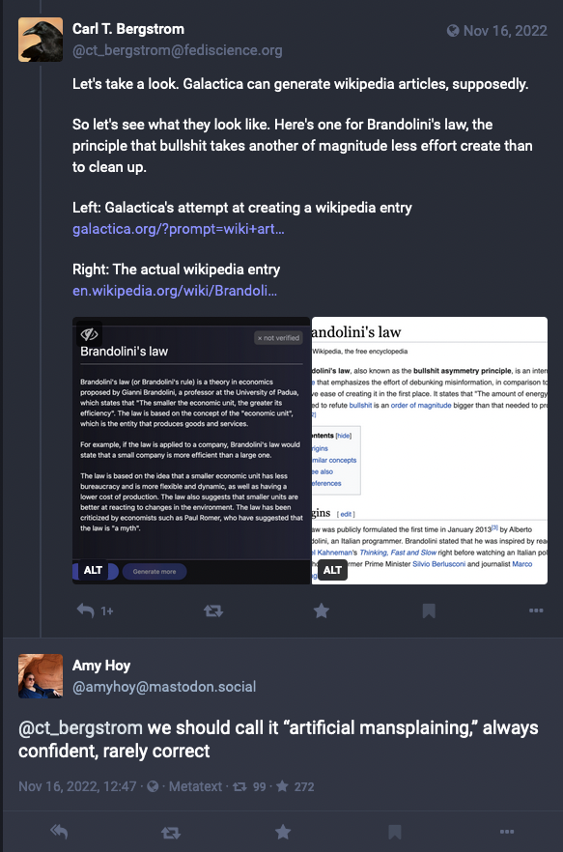
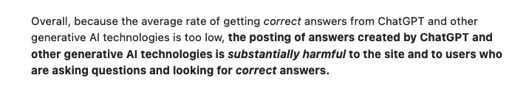

Slide 16

Cyberinfrastructure researchers have considerable power as upstream innovators but trust is fragile We need to avoid contributions to misinformation: ChatGPT quickly characterized as contributing to misinformation miasma
plale@indiana.edu

Slide 17
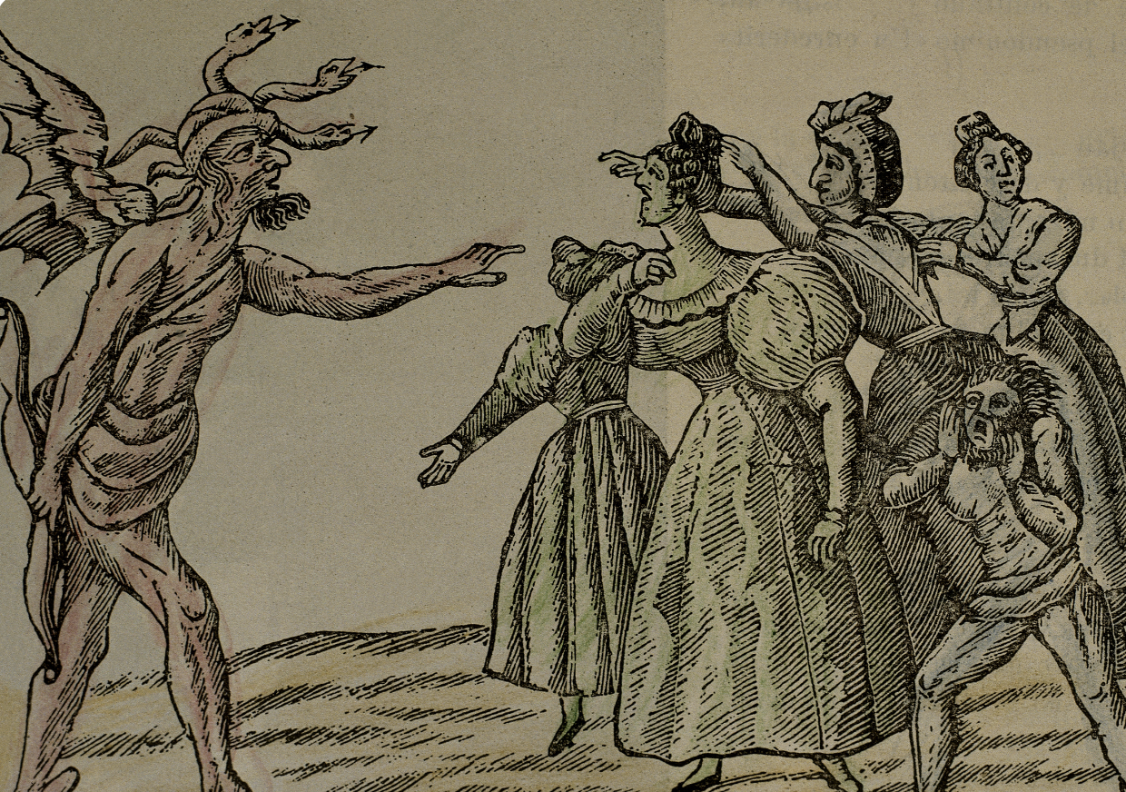
Suppose we develop an LLC backed conversational agent that we know is spews falsehoods but outperforms our rivals.
Do we publish the results?
plale@indiana.edu

Slide 18
Capture true cost in our assessments of our innovations
True Cost Accounting is the balancing of all costs and consequential costs that arise in connection with the production of a product.
How much food would really have to cost if one also included the environmental follow-up costs that arise during production and the entire supply chain.
4% price premium on conventional apples,
30% on organic mozzarella and
173% on conventionally produced meat
Notes:
For example, the production of a food product has external effects on nature (e.g., by polluting the soil, polluting water or reducing biodiversity) and on the people involved in the production (e.g., mental and physical stress, occupational diseases, among others). How negative these impacts are depends on the production system.

Slide 19
Use metrics that capture true cost of products: e.g., compare cost to build (train, retrain) and execute against (older) alternates Use that cost to make conscious deployment choices
Except in rare cases, Britain will pay for new drugs only when their effectiveness is high relative to their prices
German regulators may decline to reimburse a new drug at rates higher than those paid for older therapies, if they find that it offers no additional benefit

Slide 20

Takeaways

Slide 21
What are we encouraging with positive results lense on paper evaluation?
“metric-hacking”
Performance graphs that don’t tell the whole story. That do just enough
Iterative work
Lower rates of reproducibility. “Metric hacking” could lead to reluctance to make information available to build off piece of work or confirm finding
Tools and systems that have been designed as ignorant of broader benefit or harm
Notes:
What we don’t see is where things start to fall part

Slide 22
What can be done
Researchers capture true cost in assessments of innovations
1
Journals/conferences valuate unexpected performance results
2
Papers contain evaluations of broader considerations
3
Community encourages transparency of results reporting (reproducibility)
4

Slide 23

User Feedback
Source: Transparency and Reproducibility Practice in High Performance Computing. Plale, Malik, Pouchard. Forthcoming in IEEE Computer, 2021.
Conducted in Aug ’20
9,949 unique recipients who had participated in the SC17-19 technical programs
204 self-selected participants responded to the survey.

Slide 24
Survey Categories
Awareness of reproducibility issues | What is the goal of AD/AE?
Impact of AD/AE on reproducibility | Technology and Format of AD/AE

Slide 25
Awareness of Reproducibility Issues
Is there a reproducibility crisis in computational science and engineering?
YES
90%
Are concerns about reproducibility exaggerated?
YES
15%

Slide 26
Goal of AD/AE: Transparency Vs Reproducibility
Transparency Vs Reproducibility: Which is the goal?
Transparency
75%
Do you know the diﬀerence between transparency and reproducibility?
NO
20%

Slide 27
Impact of AD/AE on reproducibility
Have you ever used Appendix information from other SC papers?
YES
35%
Does AD/AE help you think about reproducibility of
My own work
64%
Other’s work
77%

Slide 28
Technology for AD/AE
It is suﬃcient to publish code in a repository for the purpose of reproducibility
NO
79%
Did you use containers to share results?
YES
20%

Slide 29
Cost of AD/AE: High time investment
Author time:
For majority limited to AD but can be a 1-2 worth of work.
For AE it is much longer but currently allocated as a maximum of 6 weeks.
Reviewer time:
4-5 hours for AD
20 hours for AE with 10 hours per artifact.

Slide 30
Where does author time go?
Improving quality code
Improving design
Documenting environment and files
Testing artifacts

Slide 31
Where does reviewer time go?
Identifying files for an application is a challenge
Missing workflows
Really, that data/algorithm should be part of the bundle?
No tools to check if everything relevant for the publication is submitted
No mapping of experiments to content in the paper.
No available infrastructure for efficiently verifying claimed results

Slide 32
Thank you
INDIANA UNIVERSITY BLOOMINGTON
plale@indiana.edu

